Slide 1
Is pizza a soup, salad, or sandwich?

Slide 2
Communicating Research with Effective Data Visualization
AFS2024 Workshop - Day 1
Megumi Oshima & Pavel Dimens

Slide 4
5 Minute Break

Slide 5

ggplot2::ggplot()
Plotting the “grammar of graphics” way

Slide 6
Tidy data
Month | FishID_001 | FishID_002 | FishID_003 | FishID_004
4 | 3 | 7.5 | 3.2 | 10
5 | 3.6 | 8 | 4 | 10.5
6 | 4.2 | 8.4 | 4.3 | 11
7 | 4.7 | 9.5 | 5.1 | 12
Month | FishID | TL
4 | 001 | 3
4 | 002 | 7.5
4 | 003 | 3.2
4 | 004 | 10
5 | 001 | 3.6
5 | 002 | 8
5 | 003 | 4
5 | 004 | 10.5
L
o
n
g
Wide
Notes:
The first step of creating a plot with ggplot is to tidy data into the correct format. “Long” vs “wide”
Long data frames have one row for every observation and a column for each variable
This example I have the lengths are recorded under the category of sex but in a tidy format, we would have a column for sex and a column for length separately
This makes it easier to aggregate and separate your data to make different kinds of plots without having to change the input style

Slide 7
Data properties → Visual properties
FishID | TL | Age
001 | 3 | 5
002 | 3.2 | 7.5
003 | 8.9 | 10
004 | 9.5 | 12
005 | 6 | 8
Notes:
Once you have your data table in the long form, you want to represent the numbers or categories or text in it, in a visual way. This concept is referred to as mapping. Mapping is just corresponding the properties of the data to visual properties in a graphic. For example, we have total length and age, that we are going to map to y and x positions, and then we will map those into points at those positions.

Slide 8
Data properties → Visual properties
FishID | y | x
001 | 3 | 5
002 | 3.2 | 7.5
003 | 8.9 | 10
004 | 9.5 | 12
005 | 6 | 8
Notes:
Once you have your data table in the long form, you want to represent the numbers or categories or text in it, in a visual way. This concept is referred to as mapping. Mapping is just corresponding the properties of the data to visual properties in a graphic. For example, we have total length and age, that we are going to map to y and x positions, and then we will map those into points at those positions.

Slide 9
Data properties → Visual properties
FishID | y | x
001 | 3 | 5
002 | 3.2 | 7.5
003 | 8.9 | 10
004 | 9.5 | 12
005 | 6 | 8
Notes:
Once you have your data table in the long form, you want to represent the numbers or categories or text in it, in a visual way. This concept is referred to as mapping. Mapping is just corresponding the properties of the data to visual properties in a graphic. For example, we have total length and age, that we are going to map to y and x positions, and then we will map those into points at those positions.

Slide 10
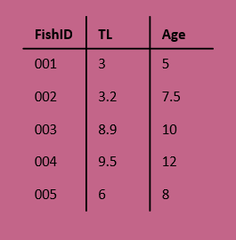
Components of a ggplot
Coordinates
(x, y)
Mapping
Data
Facets
Layers
Theme
Scales

Slide 11
Components of a ggplot
Data
Mapping
Layers
Scales
(x, y)
Facets
Coordinates
Theme
Notes:
Scale controls the mapping of values in the data space to values in the aesthetic space – taking a categorical variable like sex, and turning those into categories 1,2,3,4 and then using those to index what color to use from a vector of colors
Another example: continuous y scale maps larger numbers to vertically higher positions in space

Slide 12
Building a ggplot
Data
Mapping
Layers
(x, y)
Notes:
Data – consists of varaibles
Mapping – corresponding data properties to visual properties
Aesthetics – visual properties of geoms (line color, point shape, positions, etc)
Geoms – geometric objects that represent the data (lines, points, bars, etc)

Slide 13
Building a ggplot
Data
Mapping
Layers
ggplot(
data = blackdrum
)
(x, y)

Slide 14
Building a ggplot
Data
Mapping
Layers
ggplot(
data = blackdrum
)
ggplot(
data = blackdrum,
mapping = aes(
x = tl,
y = otoage
)
)
(x, y)
Notes:
Mapping is the set of instructions on how to make pairs of graphical attributes and parts of the data

Slide 15
Building a ggplot
Data
Mapping
Layers
ggplot(
data = blackdrum
)
ggplot(
data = blackdrum,
mapping = aes(
x = tl,
y = otoage
)
)
geom_line() +
geom_point()
+
(x, y)
Notes:
Layers are what take the mapped data and display it into a graph. Layers have 3 parts, geometry (aka how the data is displayed-line, points, bars, etc), statistical transformations (e.g. adding a trendline), position adjustments (where the data is being shown on the graph)

Slide 16
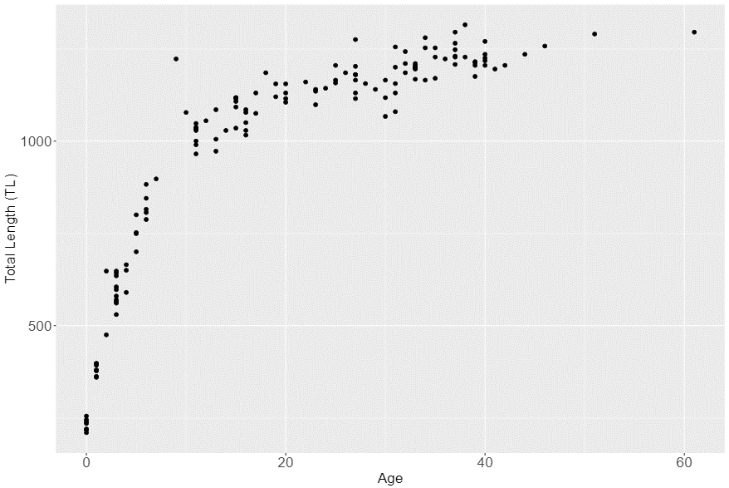
Syntax of a ggplot
ggplot(
data = blackdrum,
mapping = aes(
x = otoage,
y = tl
)
) +
geom_point(
mapping = aes(
color = sex
)
) +
labs(
x = “Total Length (TL)”,
y = “Age”
) +
theme_bw()
(x, y)
Notes:
Layers are what take the mapped data and display it into a graph. Layers have 3 parts, geometry (aka how the data is displayed-line, points, bars, etc), statistical transformations (e.g. adding a trendline), position adjustments (where the data is being shown on the graph)

Slide 17
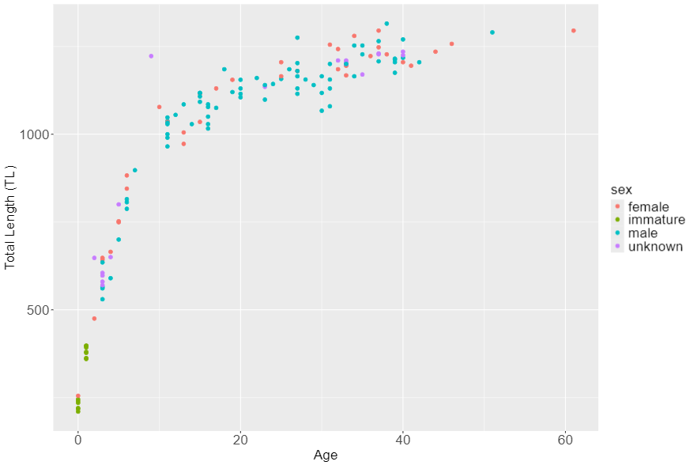
Syntax of a ggplot
ggplot(
data = blackdrum,
mapping = aes(
x = otoage,
y = tl
)
) +
geom_point(
mapping = aes(
color = sex
)
) +
labs(
x = “Total Length (TL)”,
y = “Age”
) +
theme_bw()
(x, y)
Notes:
Layers are what take the mapped data and display it into a graph. Layers have 3 parts, geometry (aka how the data is displayed-line, points, bars, etc), statistical transformations (e.g. adding a trendline), position adjustments (where the data is being shown on the graph)

Slide 18
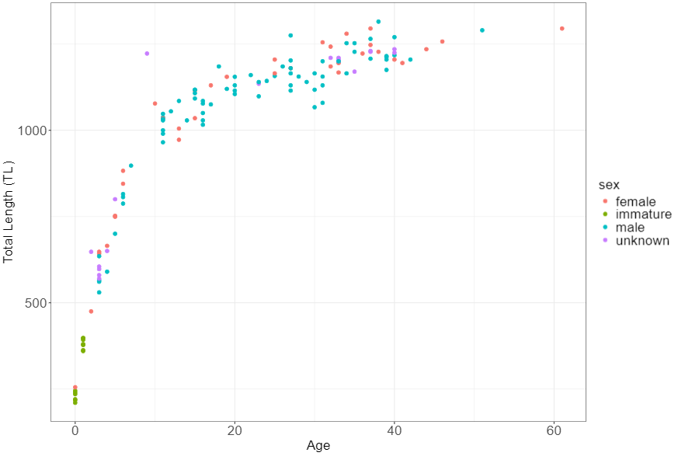
Syntax of a ggplot
ggplot(
data = blackdrum,
mapping = aes(
x = otoage,
y = tl
)
) +
geom_point(
mapping = aes(
color = sex
)
) +
labs(
x = “Total Length (TL)”,
y = “Age”
) +
theme_bw()
(x, y)
Notes:
Layers are what take the mapped data and display it into a graph. Layers have 3 parts, geometry (aka how the data is displayed-line, points, bars, etc), statistical transformations (e.g. adding a trendline), position adjustments (where the data is being shown on the graph)

Slide 19
Hands on activity
Create a ggplot to show the spread of Black Drum lengths or ages by month
Notes:
Geom_histogram
Geom_boxplot
Geom_violin

Slide 20
5 Minute Break

Slide 21
Using aesthetics to convey your message

Slide 22


Color – convey meaning
Not ideal
Better
Notes:
Color is a great way to quickly convey a message with your visualization.

Slide 23
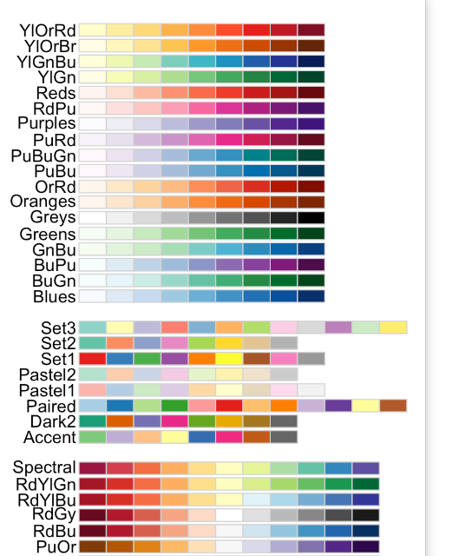
Color - continuity
A
A
B
B
C
C
A
B
C
A
B
C
Not ideal
Better

Slide 24
Color - contrast
Not ideal
Better

Slide 25
Color – (de)emphasize
Not ideal
Better
Notes:
Enough contrast between colors
Lightness
Hue
Saturation
Can add a thin outline between adjacent colors
Many visualizations benefit from emphasizing only a few categories and de-emphasizing the rest.

Slide 26
Size

Slide 27
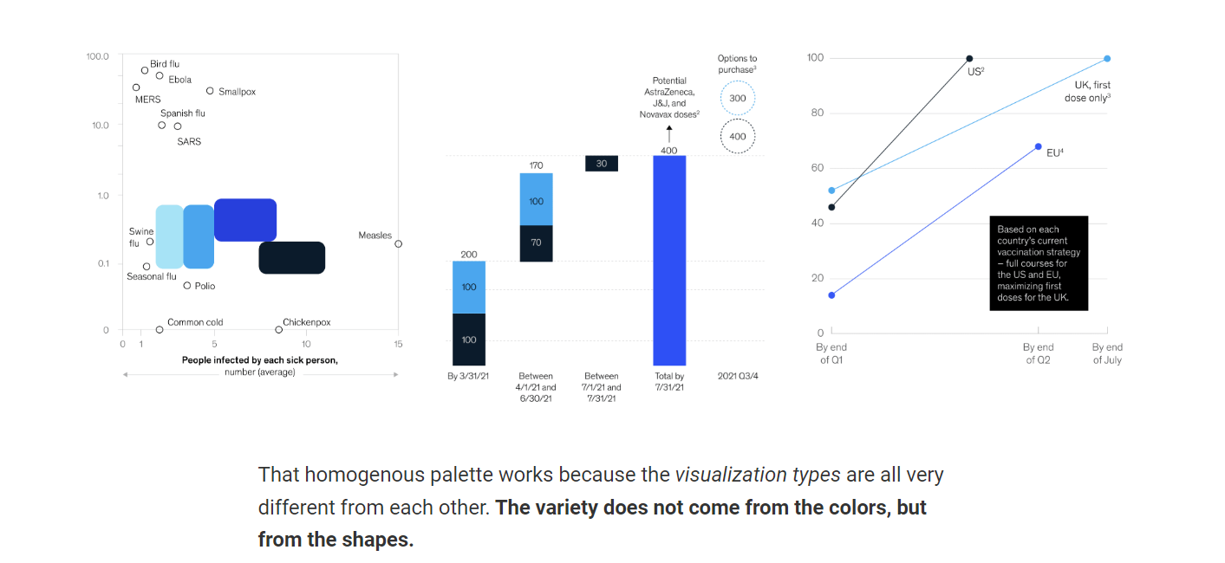
Shape

Slide 28
5 Minute Break

Slide 30
5 Minute Break

Slide 32
5 Minute Break

Slide 33
Group Project
Choose a dataset and create the plots as instructed, then improve them based on what you learned today

Slide 34

Taylor Swift Eras Tour Setlist Dataset
Goal: Communicate what contributes to the popularity of songs within the setlist.
Data collected from Spotify’s Eras Tour Setlist Playlist

Slide 35
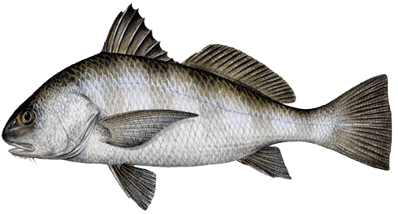
Black Drum Age and Lengths Dataset
Goal: Show the distribution of lengths-at-age for Black Drum
Data collected from Spotify’s Eras Tour Setlist Playlist

